Slide 1
Understanding Assessment in Parklands Junior School
Wednesday 21st October 2015
Assessment is not meant to be used as a measure of your child’s ability at school but as a means to improve their ability to learn; their knowledge, their understanding and their skills.

Slide 2
Aims of the session
New National Curriculum since September 2014
Expectations of the new curriculum
Assessment without levels – outline of how we are beginning to track and assess progress at Parklands Junior School

Slide 3
Why did we need a new National Curriculum?
The short answer – the Government decided that we needed one!
Before 1988 there was no National Curriculum. Teachers decided what they taught and what children needed. Over the next 26 years the National Curriculum was introduced and developed into what we had got used to until August 2014.

Slide 4
What has changed?
Lots of changes – the new curriculum is a lot more specific in English and Maths, less specific in the Foundation Subjects.
The expectations are much higher than ever before.

Slide 5
Curriculum 2014 What are the main changes to English?
Writing:
Greatly increased expectations in grammar and punctuation;
Children have to identify and label complex grammatical concepts, punctuation and spelling rules;
Expectation that children expertly use and apply the grammar and punctuation concepts in independent writing to create specific effects;
Reading:
Read for pleasure;
Word reading: pupils applying their knowledge to understand the meaning of new words;
Learning of classic & modern poetry (including reciting poetry) introduced.
Spelling:
Statutory lists of words to be learnt in Years 3 - 6;
Specific spelling rules to be taught.
Notes:
So, what are the changes to the curriculum? It would take far too long to cover the whole curriculum, particularly in any great depth.
It is also characterised by an increased emphasis on the technical aspects of language and less emphasis on the creative aspects. English is set out two-yearly in Key Stage 2. Appendices give specific content to be covered in the areas of spelling and vocabulary, grammar and punctuation.

Slide 6
New Primary Curriculum for Mathematics
What’s out?
Informal written methods of calculation
Calculators
Separate strand for using and applying
What’s there less of?
Emphasis on estimation
Less work on place value
Less work on data handling (statistics)
What’s in?
Roman numerals
Times tables up to 12 x 12
Equivalence between metric and imperial
Long division and algebra (Y6)
What’s there more of?
More challenging objectives, especially in number
Formal written methods introduced earlier
More work on fractions

Slide 7
So why have levels disappeared?
The Department for Education (DfE) decided that the children who were in Year 2 and Year 6 last year would be the last pupils to be awarded a level in their end of Key Stage tests (Summer 2015).
The raised expectations mean that children need to have a very secure knowledge of the programme of study for their year group and depth of understanding and application.
End of year expectations are now that children are ‘secure’ in their year group. This is where they need to be at the end of the year.
We have talked to the children about the changes in expectations.
Notes:
From September this year , the Government made a huge change in the way that children in schools are to be assessed.
This is to tie in with the New National Curriculum that started to be used by all schools at the beginning of the 2014 Academic Year.
Every child will be taught the programme of study for their year group.

Slide 8
New Curriculum Assessment
The Government have decided that it is up to individual schools to assess pupils within year groups.
They will set benchmarks at the end of Key Stage 1 and the end of Key Stage 2 – although they are still deciding what these will be!

Slide 10
Thank you for coming
Assessment is not meant to be used as a measure of your child’s ability at school but as a means to improve their ability to learn; their knowledge, their understanding and their skills.
Assessment is not meant to be used as a measure of your child’s ability at school but as a means to improve their ability to learn; their knowledge, their understanding and their skills.

Slide 11
STOP

Slide 12
Each year group is allocated a band – ie Year 3 – Band 3, Year 4 – Band 4, etc
Sets of statements for each subject set out the expectations for that year group.
Each band is then divided into steps – beginning, beginning +, working within, working within +, secure, secure +

Slide 13
Under the old levels system children who were secure might have moved into the next level. The DfE now want children who are in the secure bracket to add more depth and breadth to their knowledge, and to have more opportunities to develop their using and applying skills.
They are calling this phase of learning Mastery and Depth. Only exceptional children will move into working towards the end of year expectations from the year above.

Slide 14
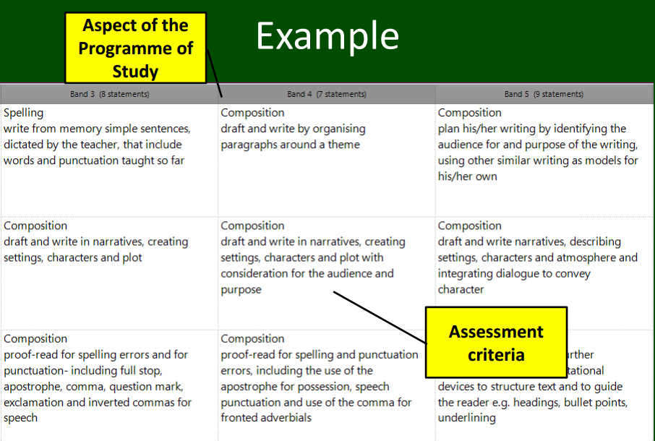

Slide 15
Beginning |  | Working within |  | Secure
Pupils have begun learning some of the criteria for the band. They may have required support or prompting with some elements. |  | Pupil learning is fully focused on the criteria for the band. Up to 70% of the statements are confidently achieved. |  | Confidence in all of the band. There may be pupil learning still focussed on gaining confidence in some minimal elements but the broad expectations for the band have been met.
B | B+ | W | W+ | S | S+

