Slide 1
Parklands Junior School
2018-19 KS2 SATs
*Contains material developed by the Standards and Testing Agency for 2018 national curriculum assessments and licensed under Open Government Licence v3.0.

Slide 2
This year Key Stage 2 SATs tests take place nationally week beginning Monday 13th May 2019.
All tests are externally marked.
Writing will be ‘teacher assessed’ internally.
Date | Test | Duration | Marks
Monday 13th May 2019 | English – Grammar and Punctuation | 45 minutes | 50
Monday 13th May 2019 | English – Spelling | 15 minutes | 20
Tuesday 14th May 2019 | English – Reading | 60 minutes | 50
Wednesday 15th May 2019 | Maths Paper 1 - Arithmetic | 30 minutes | 40
Wednesday 15th May 2019 | Maths Paper 2 – Reasoning | 40 minutes | 35
Thursday 16th May 2019 | Maths Paper 3 - Reasoning | 40 minutes | 35

Slide 3
Reading
Reading consists of a single test paper which usually contains three unrelated differentiated texts that get progressively harder.
Children have 6o minutes to complete the test which includes reading the texts and answering questions.
A total raw score of 50 is available.
Questions are designed to assess the comprehension and understanding of a child’s reading.
Some questions are multiple choice or selected response, others require short answers whilst some require an extended response or explanation.

Slide 4
*Sample Questions – Reading

Slide 5
Spelling, Punctuation & Grammar
A spelling test is administered containing 20 words, lasting approximately 20 minutes.
A separate test is given punctuation, grammar and vocabulary.
This test lasts for 45 minutes and requires short answer questions, including some multiple choice.
Marks for these two tests are added together to give a total raw score for spelling, punctuation and grammar out of 70.

Slide 6
*Sample Questions - SPAG

Slide 7
Mathematics
Children will sit three tests: Paper 1, Paper 2 and Paper 3.
The marks from all three tests are added together to get a raw score out of 110.
Paper 1 is for ‘Arithmetic’ lasting 30 minutes, covering calculation methods for all operations, including use of fractions, percentages and decimals.
Questions gradually increase in difficulty.
Papers 2 and 3 cover ‘Problem Solving and Reasoning’, each lasting for 40 minutes.
Pupils still require calculation skills but will need to answer questions in context and decide what is required to find a solution.

Slide 8
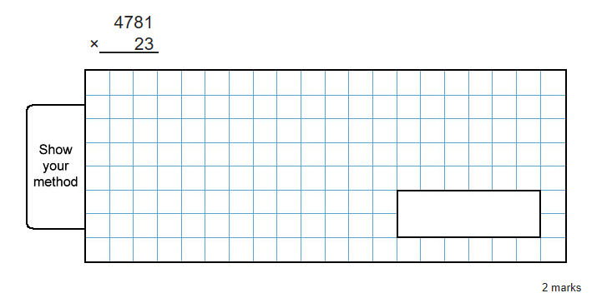
*Sample Questions – Arithmetic paper

Slide 9
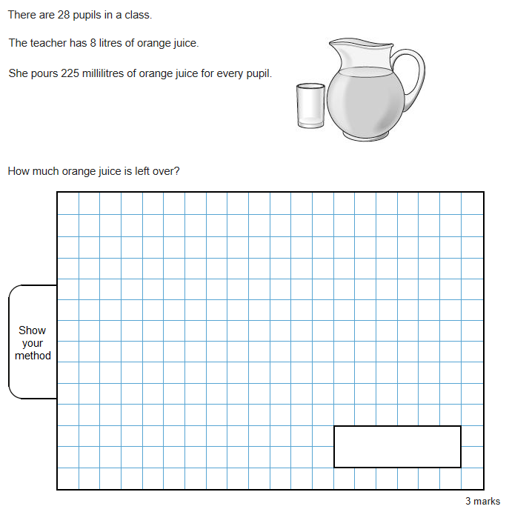
*Sample Questions - Reasoning

Slide 10
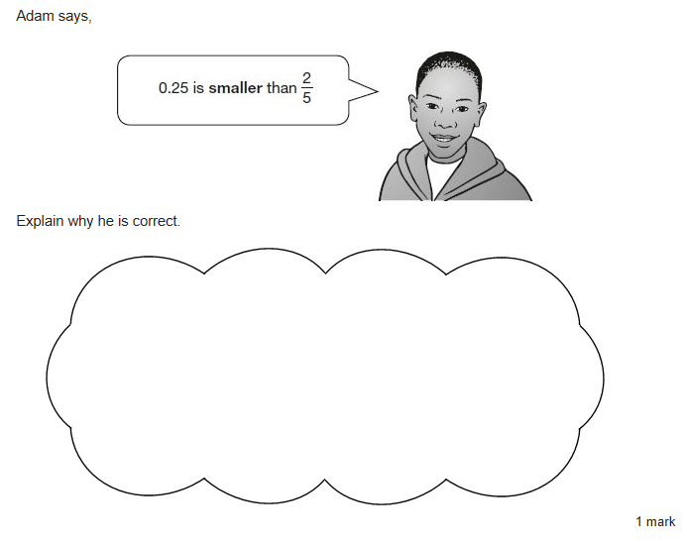
*Sample Questions – Reasoning

Slide 11
Raw Scores and Scaled Scores
Raw scores are the number of marks awarded
Each pupils raw score is converted into a scaled score.
The lowest scaled score a child can get is 80 and the highest 120.
Pupils achieving 100 – 109 are deemed to be ‘working at’ the expected standard.
110 – 120 ‘greater depth’.
Less than 100 ‘below’ the expected standard.
Your child’s results will be included in their end of year report.

Slide 12
How to Help Your Child
First and foremost, support and reassure your child that there is nothing to worry about and they should always try their best. Praise and encourage!
Ensure your child has the best possible attendance at school.
Support your child with homework tasks.
Talk to your child about what they have learnt at school and what book(s) they are reading (the character, the plot, their opinion).
All children should be reading regularly at home for sustained periods of time and be able to discuss and answer questions about what they have read.
It is imperative that all children can recall all their times tables accurately and quickly.
Spellings should be learnt thoroughly at home on a weekly basis.

Slide 13
How to Help Your Child with Reading
Listening to your child read can take many forms.
First and foremost, focus on developing an enjoyment and love of reading.
Enjoy stories together – reading stories to your child is equally as important as listening to your child read.
Read a little at a time but often, rather than rarely but for long periods of time!
Talk about the story before, during and afterwards – discuss the plot, the characters, their feelings and actions, how it makes you feel, predict what will happen and encourage your child to have their own opinions.
Look up definitions of words together – you could use a dictionary, the internet or an app on a phone or tablet.
All reading is valuable – it doesn’t have to be just stories. Reading can involve anything from fiction and non-fiction, poetry, newspapers, magazines, football programmes, TV guides.
Visit the local library - it’s free!

Slide 14
How to Help Your Child with Writing
Practise and learn weekly spelling lists – make it fun!
Encourage opportunities for writing such as letters to family or friends, shopping lists, notes or reminders, stories or poems.
Write together – be a good role model for writing.
Encourage use of a dictionary to check spelling and a thesaurus to find synonyms and expand vocabulary.
Allow your child to use a computer for word processing, which will allow for editing and correcting of errors without lots of crossing out.
Remember that good readers become good writers! Identify good writing features when reading (e.g. vocabulary, sentence structure, punctuation).
Show your appreciation: praise and encourage, even for small successes!

Slide 15
English Revision Websites
http://www.bbc.co.uk/bitesize/ks2/english/
http://www.educationquizzes.com/ks2/english/
https://uk.ixl.com/ela/year-6
http://www.crickweb.co.uk/ks2literacy.html
https://readingeggs.co.uk/

Slide 16
How to Help Your Child with Maths
Play times tables games. Times Tables Rockstars!
Make full use of Mathletics’ online resources.
Play mental maths games including counting in different amounts, forwards and backwards.
Encourage opportunities for telling the time.
Encourage opportunities for counting coins and money; finding amounts or calculating change when shopping.
Identify, weigh or measure quantities and amounts in the kitchen or in recipes.
Play games involving numbers or logic, such as dominoes, card games, darts, draughts or chess.
Practice papers are available online.

Slide 17
Maths revision websites:
www.mathletics.com
www.ttrockstars.com
http://www.primaryhomeworkhelp.co.uk/maths/
www.ixl.com
https://www.bbc.com/bitesize/subjects/z826n39
https://www.educationquizzes.com/ks2/maths/

Slide 18
Recommended CGP Books for Use at Home
Please complete the order form and return to the school office with payment by the 6th December at the latest.
Your child will be informed about whether they need the standard or stretch books for maths and reading – please check their reading records for this information.
The grammar, punctuation and spelling book is the same level for all pupils.
If in any doubt please speak to the class teacher for advice.

Slide 19
Thank you for attending this evening. Please complete the evaluation form before leaving. If you have any further questions regarding SATs please speak to your child’s class teacher or Mrs Carter. This presentation and a selection of resources to help you support your child are available on the website.
*Contains material developed by the Standards and Testing Agency for 2018 national curriculum assessments and licensed under Open Government Licence v3.0.

