Slide 1
Maths Workshop
Parklands Junior School
Friday 8th November 2019
Miss Hussey

Slide 2


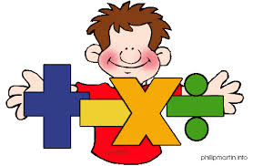
Thinking is at the heart of Mathematics and therefore should be at the heart of Mathematical teaching and learning. At Parklands we believe that all children can do Maths (and do it well).

Slide 3
Aims of today’s meeting
To get an insight into how Maths is taught at Parklands Junior School.
To gain an understanding of the National Maths curriculum and expectations.
To take part in some Maths activities.
To take away some ideas to support your children at home.

Slide 4
Progression of Times tables
Year 2 | Year 3
Counting in multiples of 2s, 3s, 5s, 10s | Fluent 2s, 3s, 4s, 5s, 8s, 10s multiplication facts
Year 4
Fluent in all times tables, up to 12 x 12, by the end of Year 4.

Slide 5
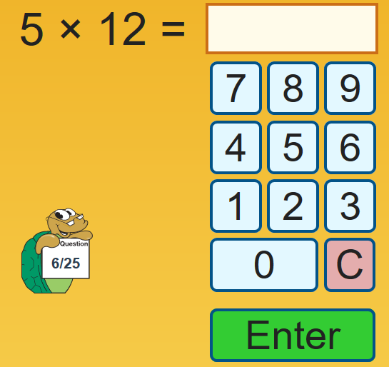
UR Brainy https://urbrainy.com/mtc

Slide 6
Progression of Addition & Subtraction
Year 3 | Year 4
•add and subtract numbers mentally, including: •a three-digit number and 1s •a three-digit number and 10s •a three-digit number and 100s •add and subtract numbers with up to 3 digits, using formal written methods of columnar addition and subtraction | •add and subtract numbers with up to 4 digits using the formal written methods of columnar addition and subtraction where appropriate •estimate and use inverse operations to check answers to a calculation
Year 5
•add and subtract whole numbers with more than 4 digits, including using formal written methods (columnar addition and subtraction) •add and subtract numbers mentally with increasingly large numbers
Year 6
Pupils practise addition, subtraction, multiplication and division for larger numbers, using the formal written methods of columnar addition and subtraction, short and long multiplication, and short and long division

Slide 7
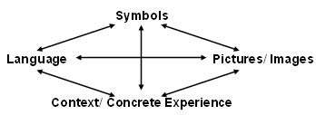
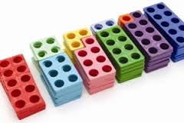
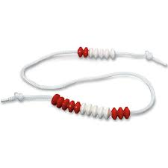

Concrete, Pictorial, Abstract Approach
=
+
x
%
subtract
more
add
sum
factor
product
When we plan a Maths sequence we always ensure children are exposed to correct mathematical language, symbols (+ - = x), an image and a context.

Slide 8
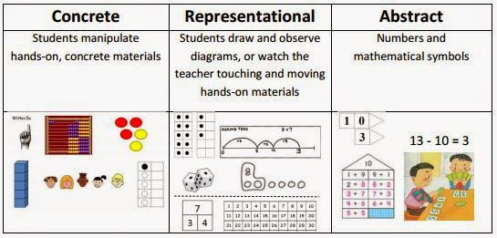

Slide 9
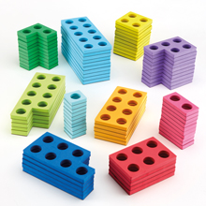
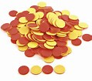
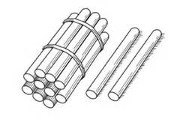
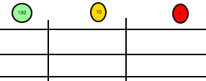
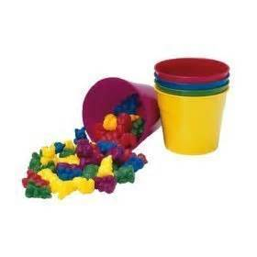
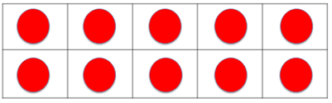
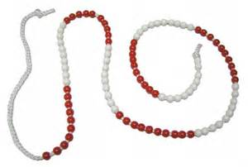
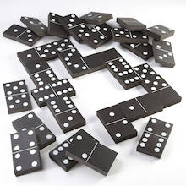
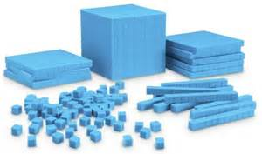
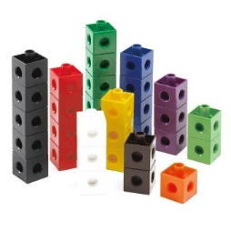
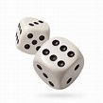
A range of resources

Slide 10
Importance of concrete
Real things and structured images enables children to understand the abstract.
The concrete and the images are a means for children to understand the symbolic so it’s important to move between all modes to allow children to make connections
Morgan, D. (2016)
Used well, manipulatives can enable pupils to inquire themselves- becoming independent learners and thinkers. They can also provide a common language with which to communicate cognitive models for abstract ideas.’
Drury, H. (2015)
Jean Piaget's (1951) work suggests that children aged seven to ten years old work in primarily concrete ways and that the abstract notions of mathematics may only be accessible to them through embodiment in practical resources.

Slide 11
Why is CPA so important? (1)
It gives children a deep understanding of maths
Concrete resources give time pupils to investigate a concept first - and then make connections when formal methods are introduced

Slide 12
Why is CPA so important? (2)
The pictorial stage allows pupils to demonstrate and sustain their understanding of mathematical concepts and processes
The abstract stage should run alongside the concrete - pictorial stage (enables pupils to read mathematical statements and show their understanding using concrete resources or pictorial representations).

Slide 13





Multiple representations
13 ÷ 4 = 3 remainder 1
Tens | Ones
Notes:
Show your staff the different representations.
(i) Counters shared between 4
Can be done physically with bean bags and hoops or counters and circles. However the grid is ideal for bar modelling (sharing).
(ii) Grouping with place value counters
Start by making the number 13. This could also be done with base 10. Look at the tens: can I make any groups of 4? No, but can I make an exchange? Yes, I exchange one ten for ten ones. I can make 3 groups of 4 with one left over.
(iii) Rods and rulers for repeated subtraction
We want to see how many fours go into 13. Pupils should start at 13 on their rulers and use the Cuisenaire rod that is worth 4. They must always arrive at 0. Three whole fours with 1 left over go into 13.
(iv) Numicon encourage grouping
Start by making the number 13. How many fours go into 13? Place the number four alongside the number 13. Three fours with one left over make 13.

Slide 14
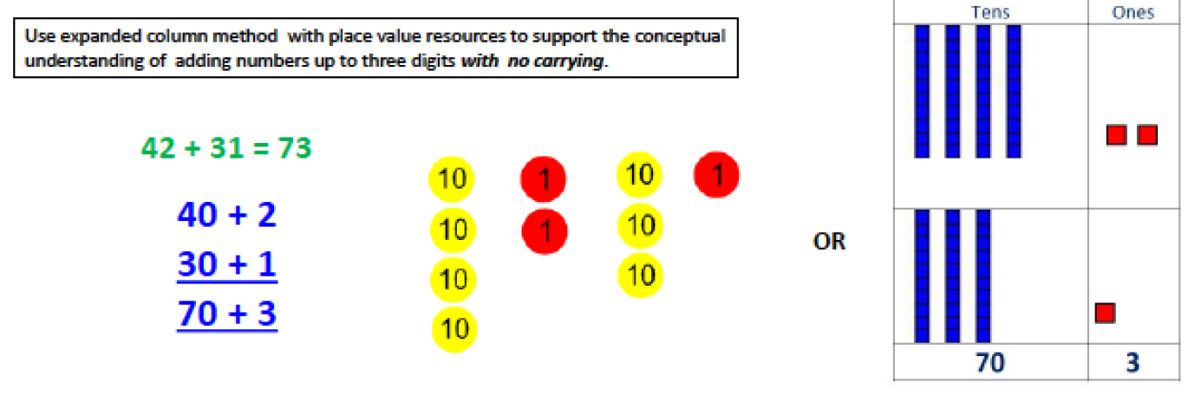
Addition: Year 3
Statutory requirements:
add and subtract numbers mentally, including:
•a three-digit number and 1s
•a three-digit number and 10s
•a three-digit number and 100s
•add and subtract numbers with up to 3 digits, using formal written methods of columnar addition and subtraction

Slide 15
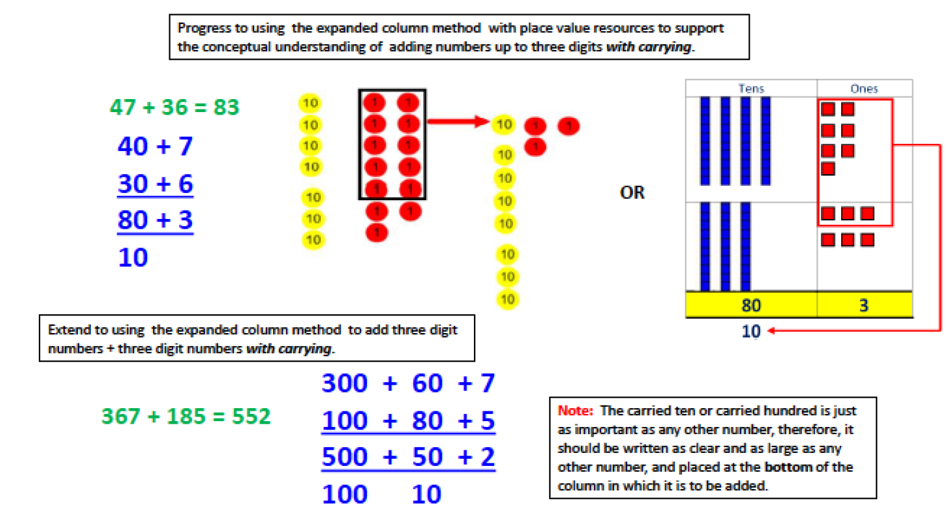
Year 3

Slide 16
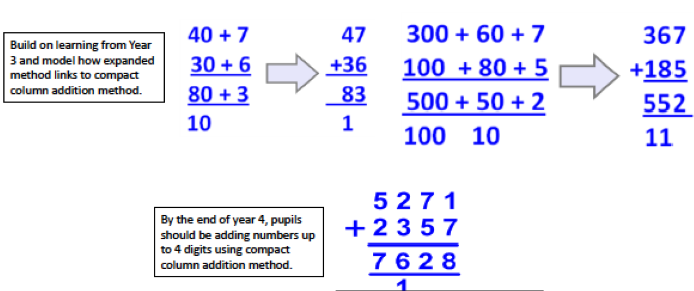
Addition Year 4
•add and subtract numbers with up to 4 digits using the formal written methods of columnar addition and subtraction where appropriate
•estimate and use inverse operations to check answers to a calculation

Slide 17
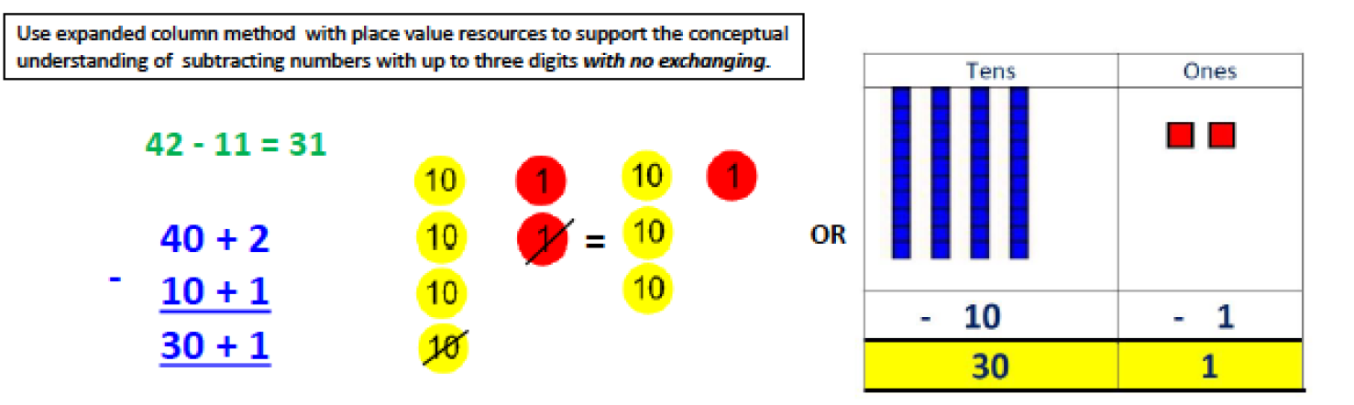
Subtraction Year 3
add and subtract numbers mentally, including:
•a three-digit number and 1s
•a three-digit number and 10s
•a three-digit number and 100s
•add and subtract numbers with up to 3 digits, using formal written methods of columnar addition and subtraction

Slide 18
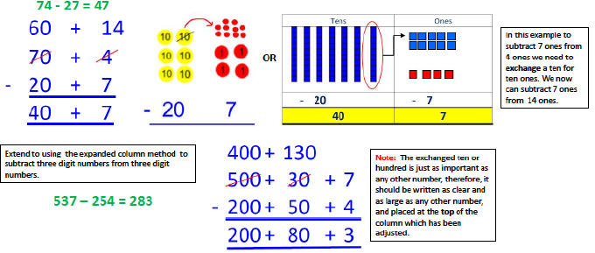
Year 3

Slide 19
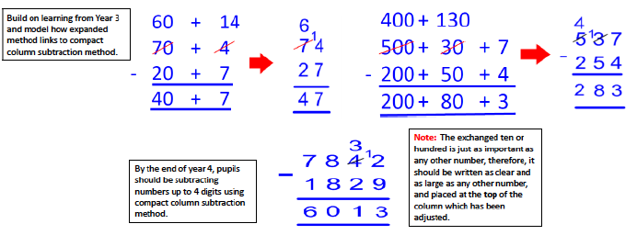
Subtraction Year 4
•add and subtract numbers with up to 4 digits using the formal written methods of columnar addition and subtraction where appropriate
•estimate and use inverse operations to check answers to a calculation

Slide 20
Over to you!
Use the expanded method to solve:
236 + 196
Use the expanded method to solve:
87 - 28

Slide 21
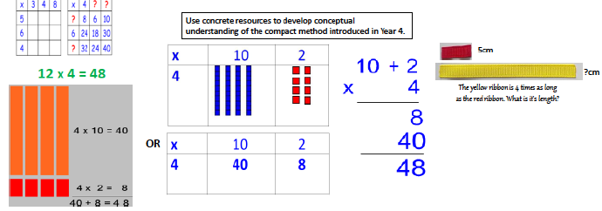
Multiplication Year 3

Slide 22
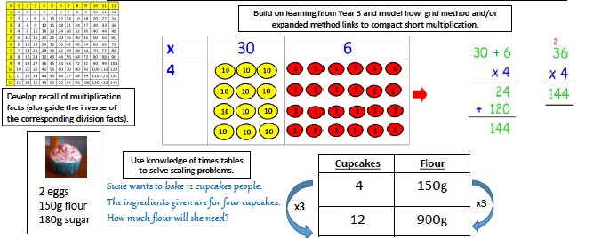
Multiplication Year 4

Slide 23
Your turn
Use the expanded method for multiplication to solve:
38 x 6

Slide 24
Problem Solving
Problem solving is the essence of maths and has been brought to the forefront of the new curriculum.

Slide 25
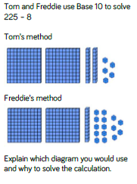
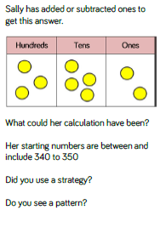
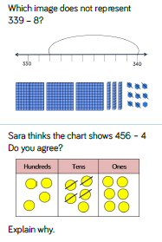
Examples-
Year 3

Slide 26
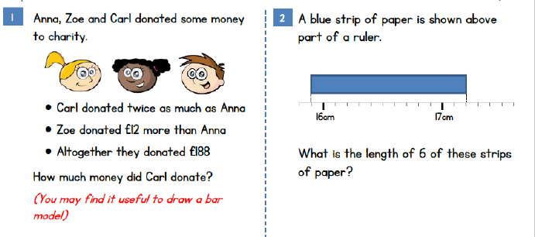

Slide 27
Problem solving, what and why?
One of the main reasons for studying mathematics is to develop the ability to solve problems. Problem solving is the process of applying what we already know to new and unfamiliar situations. This ability is not only critical to our children’s future needs, but also to a productive society and even human progress itself. In these early years, children develop attitudes and beliefs as to their ability to learn mathematics. By learning mathematics through problem solving, children can make sense of why they need to know their basic facts.
How Can Parents Help?
• Be enthusiastic. Let your child see how excited you are about solving a problem.
• Provide time and talk about problem solving. Be patient with your child. Let them work at their own pace. Talk, talk, talk! Talk about options, strategies and ideas for problem solving.
• Reinforce risk taking. Children need a great deal of security to risk being wrong. When they begin to realize that they can learn from their mistakes, they will try harder to complete the problem.
• Reward perseverance. Instant success is not always possible in learning mathematics. Encourage children to keep trying by asking them questions that will lead them in the right direction.
• Use children’s experiences. As often as possible, base problems on children’s everyday experiences at school and at home.

Slide 28
The best way for your children to become good problem solvers is for them to solve problems, lots of problems! Also, it benefits children to think about how they solved the problem afterwards. In this way they may use their particular strategy to solve similar problems in the future. There are no best ways of solving a problem. We are interested in what makes sense to each individual. Here are some strategies to try with your child: ~ act it out ~ use objects or models ~ make a drawing ~ make a graph or chart ~ make a list ~ guess and check ~ sort and order items ~ look for a pattern ~ look for all possibilities ~ solve a simpler problem ~ choose an operation ~ think logically, use what you know.
Here is how we tackle problem solving in the classroom:
1.Think. Make sure that you know what the problem is all about. Do you understand all the vocabulary? Do you know what information is given? Is anything missing? Can you restate the problem in your own words? Do you understand exactly what you are asked to do or to find out?
2.Plan. Think of some strategies to try, that might help you find the answer.
3.Do. Try to solve the problem using the strategy from your plan. If your plan doesn’t work try again with another strategy.
4.Look back. Think about and talk about how you solved the problem. Can you think of another way that you could have solved the problem?
5.Communicate. Explain your work clearly, using words, pictures and numbers. Explain the thinking and processes that you used to solve the problem.

Slide 29
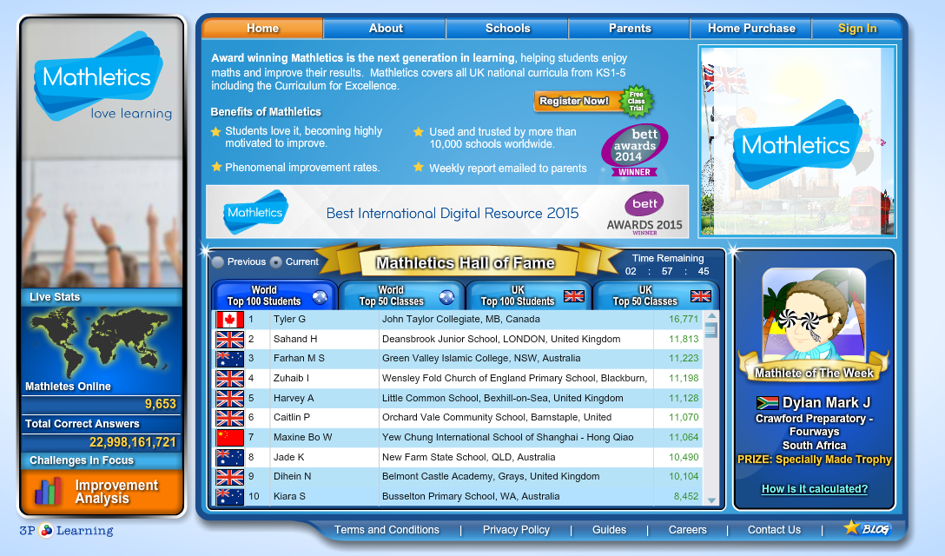
Mathletics
Notes:
SJ

Slide 30
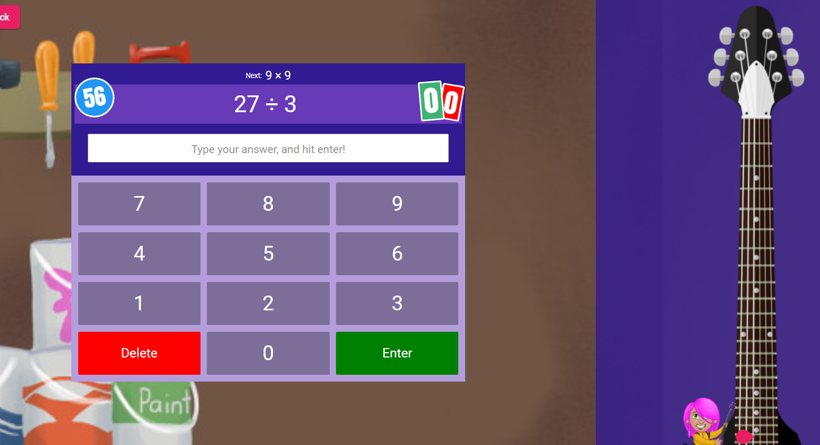
Times Tables Rock Stars
Notes:
SJ

